Slide 1
Blockchain Final Project Quartet Ron Friedman 209490358 Netanel Konforty 312463425

Slide 2
Introduction
Quartet Game is a popular game in Israel.
Sometimes people cheat while playing this game.
Therefore we came up with the idea to build a playing system based on blockchain and verification with merkle tree

Slide 3

Technologies
Visual Studio Code
Remix
MetaMask
Soldiity
Html
CSS
JavaScript
NodeJS
Web3JS
Cmd Shell
Truffle
Ganache

Slide 4
Quartet Card Game

Slide 5
4 Players
40 Cards, separated to 10 categories, 4 cards each.
The winner is the player with the biggest number of sets of 4 cards from the same family.
Each player, in his turn, can ask one other player for a card from one of the categories he has.

Slide 6
You can buy some extraordinary utilities using the winning prizes:
Joker – Can be any card
Swapper – Swap your cards with other player
Watcher – Watch other player’s cards

Slide 7

Known Bugs

Slide 8
Client doesn’t validate the entered pk belongs to the user
We can’t declare Card as contract because it causes the initial transaction fee (which is the cost of the deployment process) to oversize the max gas limit, so we have declared Card as struct. In addition, also when Card is declared as a struct, we can’t declare 40 cards as we want, so we have declared only 16 cards.

Slide 9
Because of max gas limit issues, not all functionalities currently working, hopefully will be fixed until next class.

Slide 10
Parts

Slide 11

Contracts
Quartet.sol
Card.sol
QuartetCoin.sol

Slide 12
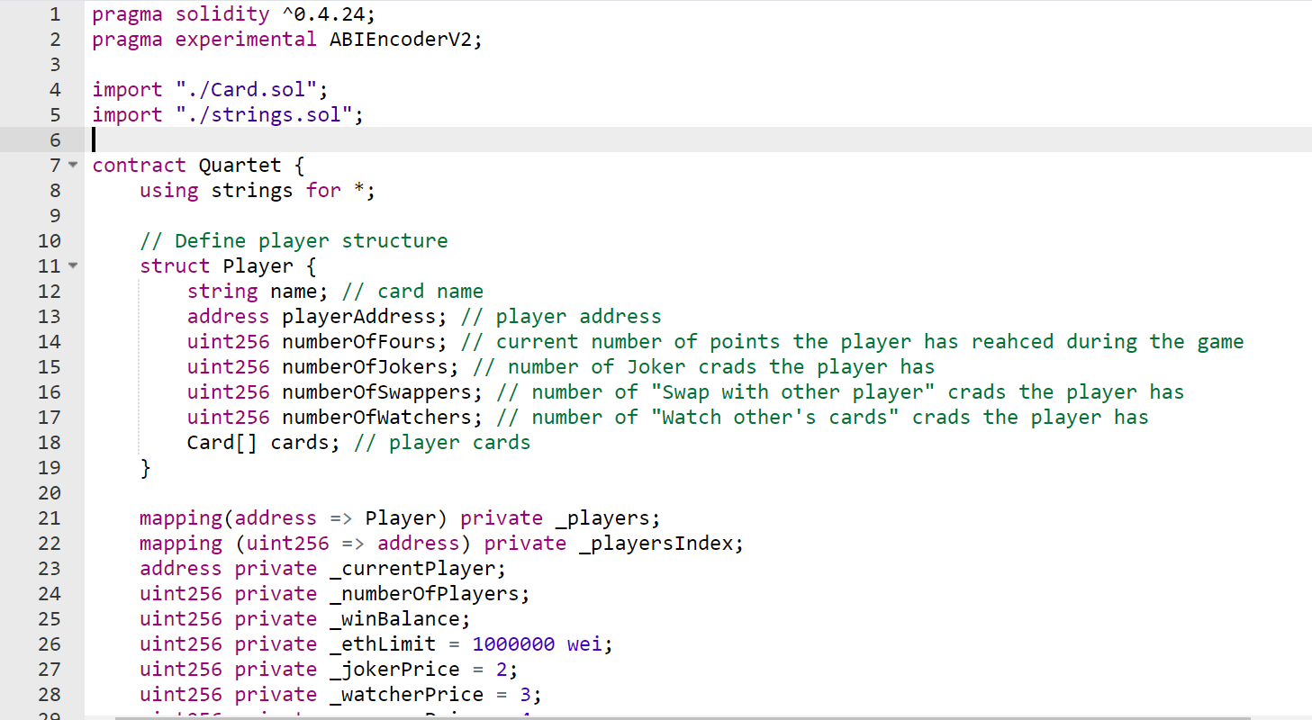
Quartet.sol is the main contract – the main that is being called according to user choices in the game.

Slide 13
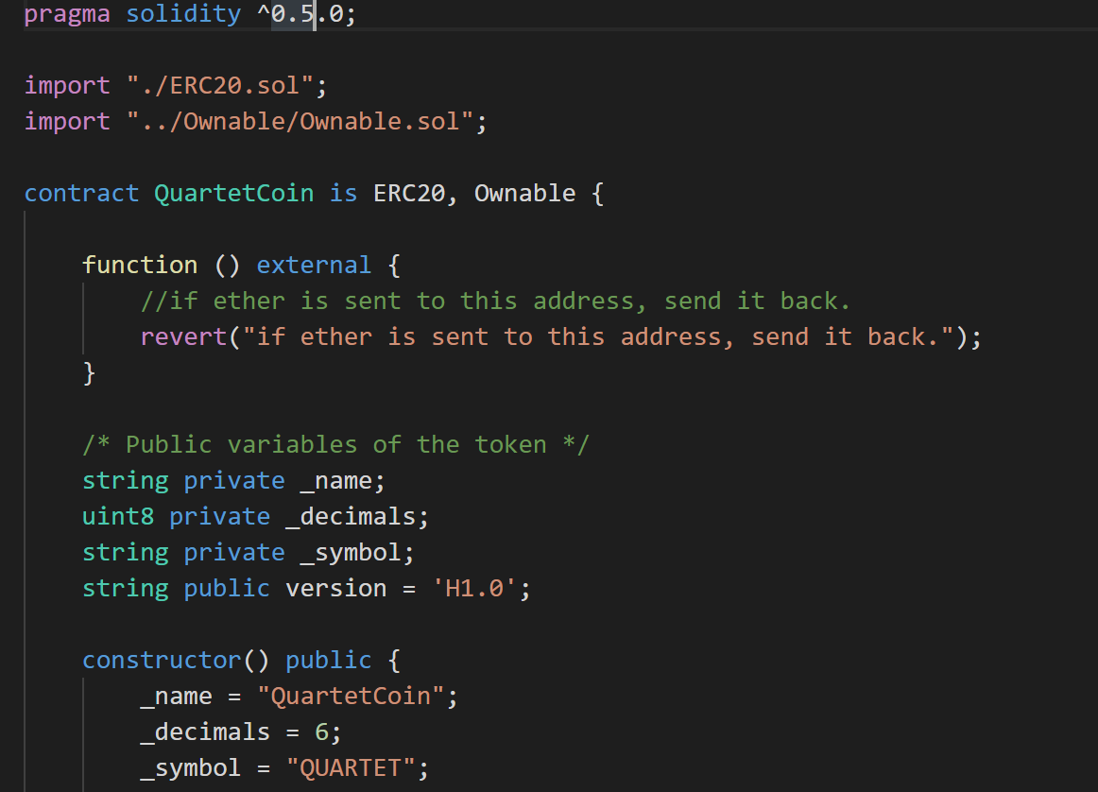
QuartetCoin.sol is a contract that represents our ERC20 token that is used for buying stuff and as winning prize.

Slide 14
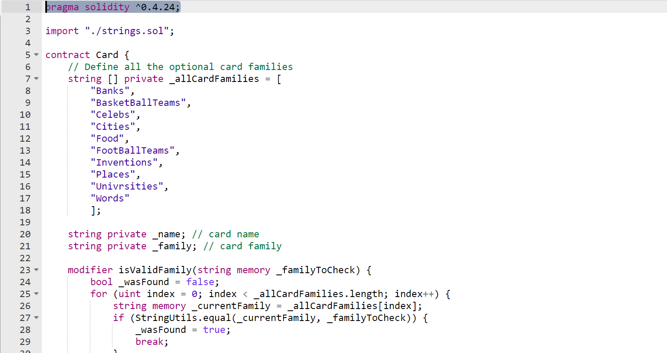
Card.sol is a contract that represents the basic element in the game – a card, a card that has name and family. In addition, every card has hash.

Slide 15

GUI
Html
JavaScript
Css
Web3JS
NodeJS

Slide 16
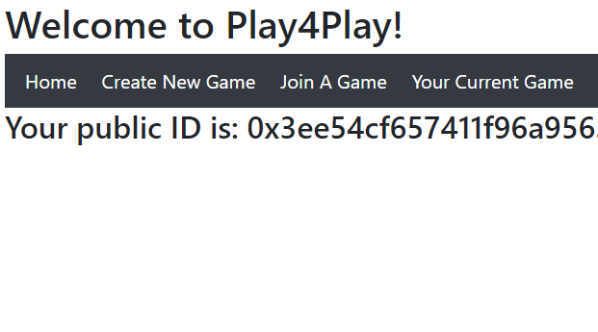
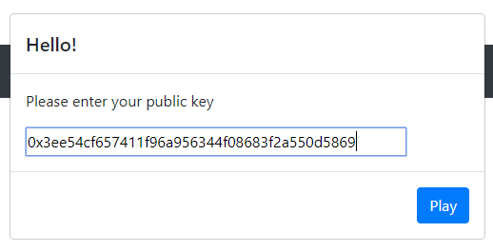
The Main Page - where the player should insert his/her public key and than start playing.

Slide 17
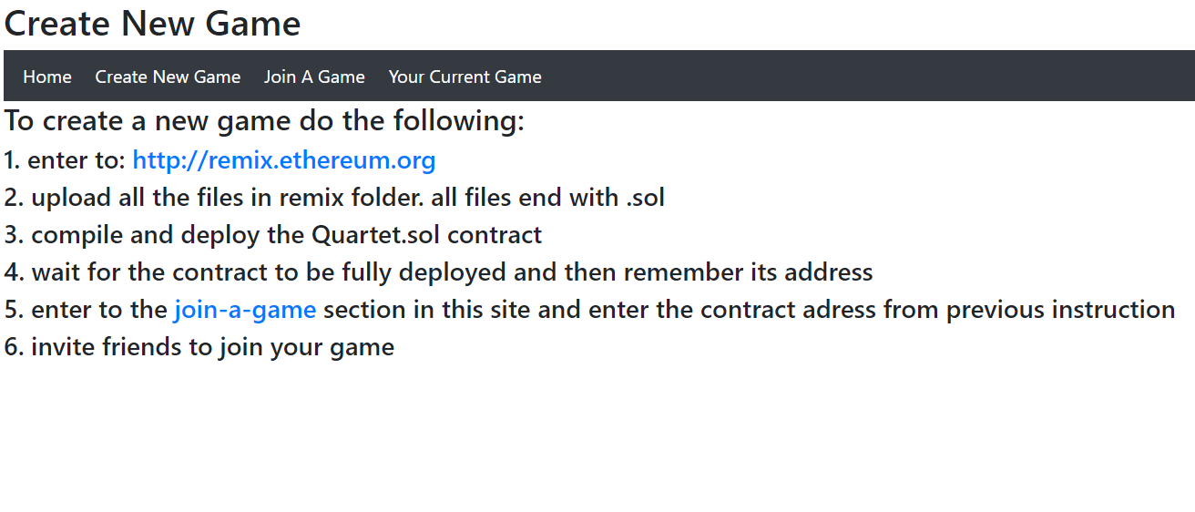
Create New Game
The player can create his own game and wait for other players to join his game

Slide 18
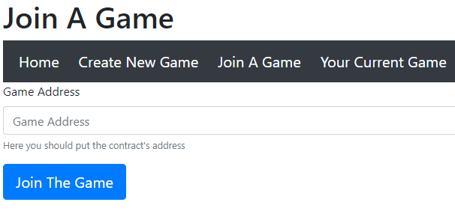
Join A Game
The player can enter the address of the contract he wishes to enter

Slide 19
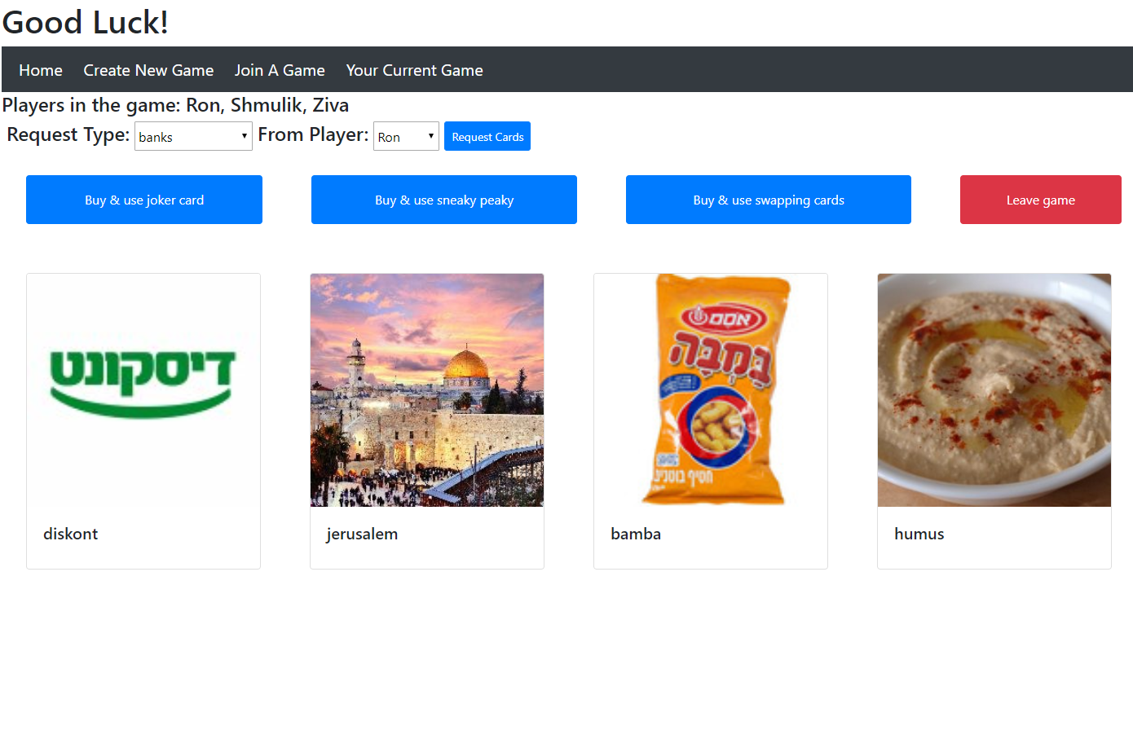
Current Game
The actual game. The player can see his own cards, ask other players for cards and buy special cards using Tokens.

Slide 20

How to Run & Play ?

Slide 21

Place your screenshot here
Compile and Deploy Quartet contract and QuartetCoin contract.
Entering the abi and the contract’s address.

Slide 22
Place your screenshot here
Cloning the project
Change current directory to src
Using cmd: npm install
Using cmd: node app
Using chrome, enter to: http://localhost:3000/

Slide 23

Dare To Dream – Future Features
Live Messages From Server

Slide 24
Any Questions ?

